Slide 1

NM1026 - ANDROID APPLICATION DEVELOPMENT SNACK ORDERING AND DELIVERING APP
TEAM MEMBERS:
S MONISHA - 711222104030
L MYTHILI -711222104032
D SOWMIYA -711222104048
P SUBHAASREE -711222104051

Slide 2
ABSTRACT :
The Android-based snack ordering and delivery website is designed to simplify the process of ordering snacks. Users can browse a wide range of snacks, place orders, and make secure payments directly through the app. The system provides real-time order tracking, so customers can see when their order is being prepared and delivered. Push notifications and alerts keep users updated, ensuring a seamless and convenient experience.
For vendors, the platform helps manage inventory, track sales, and offer discounts or promotions easily. Delivery personnel benefit from GPS integration, allowing them to deliver orders quickly and efficiently. The system provides a more efficient and user-friendly way for customers to order snacks, while also helping vendors streamline their operations and delivery services.

Slide 3
INTRODUCTION :
An Android-based snack ordering and delivery website offers a convenient platform for customers to order snacks directly from their smartphones and have them delivered to their doorstep. Users can easily browse a variety of snacks, place their orders, and make secure payments through the app. The system provides real-time updates and notifications, keeping customers informed about their order status and delivery progress.
For businesses, this platform simplifies snack management and delivery operations. Vendors can efficiently manage their stock, offer discounts, and monitor orders. Delivery personnel benefit enabling faster and more efficient deliveries. Overall, the platform enhances the snack ordering process, making it faster, more accessible, and user-friendly for both customers and vendors.

Slide 4
PROBLEM DEFINITION :
In traditional snack ordering, customers often face inconveniences such as limited snack options, long wait times, and a lack of transparency regarding order status. Snack vendors struggle with managing orders, inventory, and delivering items on time, especially during peak hours. Delivery systems are inefficient without proper route planning, leading to delays, while customers have no way to track their orders or receive updates in real time. Additionally, manual payments and order-taking increase the likelihood of errors, reducing customer satisfaction.
SOLUTION :
The Android-based snack ordering and delivery website offers a digital solution to these problems. Customers can easily browse available snacks, place orders online, and make secure payments through the app. The system sends real-time order updates and allows users to track deliveries using GPS.

Slide 5
Vendors can efficiently manage their inventory, monitor orders, and offer promotions through the platform. Delivery personnel benefit from optimized route planning via GPS, ensuring faster delivery and improved service.
ADVANTAGES :
Convenience: Customers can browse and order snacks from anywhere using their smartphones.
Real-Time Tracking: Users receive real-time updates and can track their orders, reducing uncertainty.
Faster Delivery: GPS-based route planning for delivery agents ensures quicker and more efficient delivery.
Improved Vendor Management: Vendors can easily manage their inventory, track orders, and offer discounts or promotions.
Secure Payments: The app provides secure, cashless payment options, reducing errors and improving the user experience.

Slide 6
HARDWARE REQUIREMENTS : • Server: Intel Core i5 or higher, 8GB RAM, 500GB SSD, high-speed internet connection (100 Mbps or more) • Client (Customer’s Android Device): Quad-core processor, 2GB RAM, Android 8.0 or later. • Delivery Personnel Device: Quad-core processor, 2GB RAM, built-in GPS, Android 8.0 or later. SOFTWARE REQUIREMENTS : •Operating System: Linux (Ubuntu 20.04+) or Windows Server 2019 (Server), Android 8.0+ (Client). •Backend: Python (3.8+), Node.js (v14+), or Java (11+) with Django, Flask, or Express frameworks. •Database: MySQL (v8.0+), PostgreSQL (v12+), or MongoDB (v4.4+). •Payment Integration: Razorpay, PayPal, or Stripe SDK. ▬ 6

Slide 7
SYSTEM ARCHITECTURE : • Inputs: Customer Orders: Snack selection, quantity, payment details. Vendor Inventory: Stock updates, discounts. Delivery Requests: Delivery location, time preferences. • Processing: Order Management System: Validates orders, processes payments. Inventory Management: Tracks and updates stock availability. GPS Tracking System: Plans optimized delivery routes and tracks delivery in real-time. • Outputs: Order Confirmation: Receipt and estimated delivery time. Real-Time Tracking: Live GPS updates for customers. Delivery Notifications: Alerts and successful delivery confirmation. 7

Slide 8
IMPLEMENTATION :
The Android-based snack ordering and delivery system is built step-by-step to ensure smooth operation. The app is created for customers to browse and order snacks, while a web dashboard is designed for vendors to manage their inventory and orders. The backend system handles order processing, inventory, and delivery tracking, while using Google Maps for GPS tracking and Firebase for notifications.
STEPS FOR IMPLEMENTATION :
• Design: Plan the app’s look, database, and how the app connects with the server.
• Backend Development: Create server functions to handle snack orders, inventory, and track deliveries.
• App Development: Build the customer-facing app where they can browse, order, and track their snacks.
• Testing: Ensure the app works correctly on different devices and conditions.
Deployment: Launch on cloud server & make the app available on the Google Play Store.

Slide 9
MODULES :
•User Module: Users sign up, browse snacks, place orders, and track them in real-time.They can securely pay using integrated payment options.
•Vendor Module: Vendors sign in, manage their snack listings, check stock, and process orders.They can view sales and offer discounts.
•Order Management Module: Handles the process from placing the order to assigning it to a delivery person and updating the order status.
•Delivery Module: Delivery staff log in, see assigned orders, and use GPS to find the best route to deliver snacks.They update the delivery status when an order is completed.
•Payment Module: Customers pay for their snacks securely using online payment systems like Razorpay or PayPal.The app generates digital receipts for each transaction.

Slide 10
RESULTS AND INSIGHTS :
The system delivers seamless snack ordering with real-time tracking and timely delivery, ensuring accurate order confirmations and notifications for improved user satisfaction. It also provides valuable insights, such as identifying popular snack trends through order data and optimizing delivery efficiency using GPS tracking. Additionally, inventory trends enable vendors to manage stock effectively and plan promotions strategically. These results and insights collectively enhance customer experience, streamline operations, and drive business growth.

Slide 11
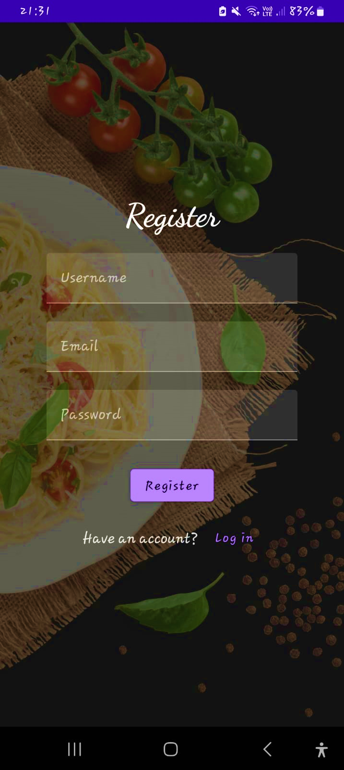
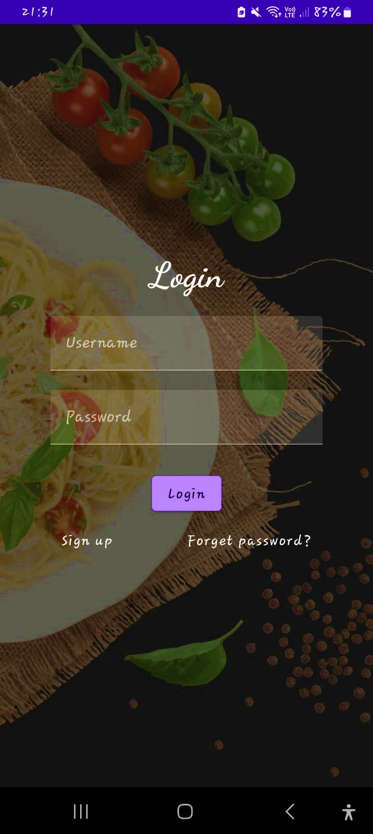
OUTPUT :

Slide 12
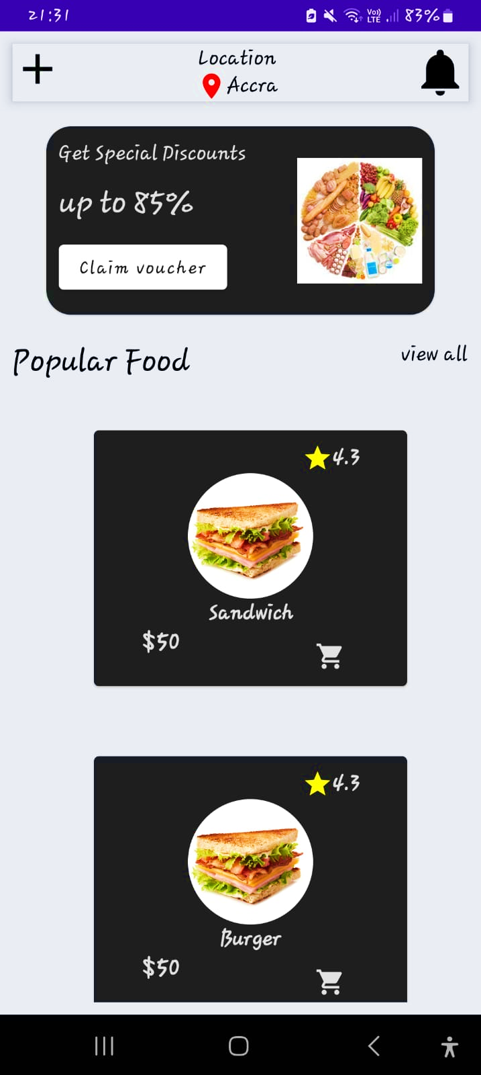
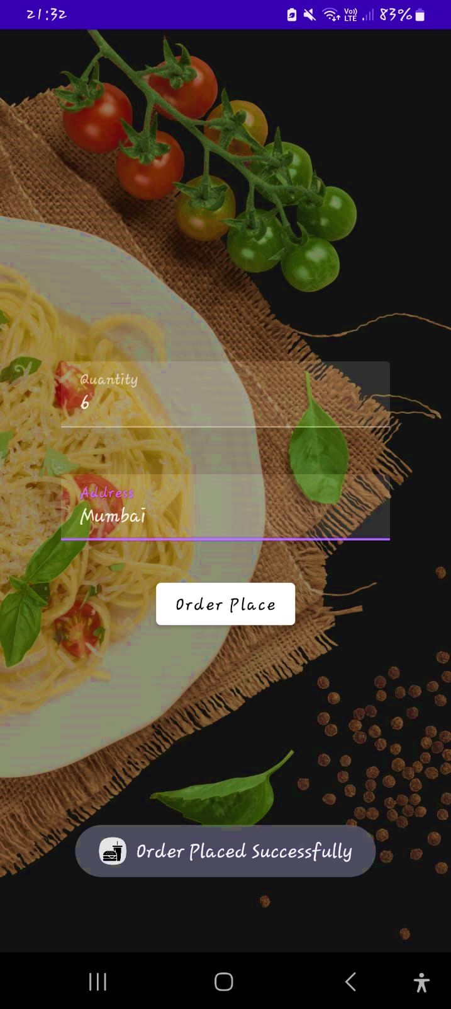

Slide 13
CONCLUSION :
The Android-based snack ordering and delivery system offers a convenient, efficient, and modern solution for both customers and vendors. By providing an easy-to-use mobile app, customers can browse, order, and track their favorite snacks with just a few taps, enjoying faster deliveries and real-time updates. Vendors benefit from simplified inventory management, streamlined order processing, and the ability to reach more customers. The integration of secure payments and GPS-based delivery tracking further enhances the user experience. Overall, this system improves the snack ordering process, making it more accessible, reliable, and customer-friendly.
13

Slide 14
THANK YOU !!

